Slide 1
Hands-On Career Fairs
College Changes Everything Conference
July 2016

Slide 2
Grundy County
Who
Business Education Council
School districts, vocational center, Chamber of Commerce, trades, local business, U of I Extension, JJC Grundy Workforce Services, Community Foundation, TREES (Three Rivers Education-to-Employment Services)

Slide 3
Grundy County
What
An expo for all 8th grade students in Grundy County and the surrounding area
Each booth must have a “hands-on” component so students can touch and experience something in that industry, even if it’s just a game to get students interacting
NOT opportunity for businesses to recruit to work – it’s about recruiting talent to your career and explain path of education/training to get there

Slide 4
Grundy County
Where
Morris Community High School Fieldhouse
Space for 150 expo booths
Use outdoor space for equipment (tractors, fire trucks, etc.) plus companies that would rather be outdoors

Slide 5
Grundy County
When
First two expos were in the spring
8th grade class of 2016-17 school year will come in October
Date is chosen by superintendents depending on testing days and other school events
Districts plan it as a field trip so busing is provided

Slide 6
Grundy County
Why
Talking about careers isn’t enough – students tune it out
Touching and experiencing exhibits gives them a better idea of what that career involves

Slide 7
Grundy County
Grundy chooses 8th grade so students can better select classes for that career path in high school
Grundy Area Vocational Center is for juniors and/or seniors
2-hour time block so some students need to be strategic about freshman-sophomore classes in order to be eligible for GAVC

Slide 8
Grundy County
How
Expo is organized by staff of Community Foundation of Grundy County and Grundy Area Vocational Center
Business Educational Council is steering committee

Slide 9
Grundy County
Timeline

Slide 10
Grundy County
6 months out
Get date from superintendents
Book field house
Book “pipe and drape” for expo area (approx. $2,000 for 100 booths)
Compile spreadsheet of business contacts
Mail letter of invitation to area businesses
Help superintendents convey message and purpose to principals and 8th grade teachers

Slide 11
Grundy County
4 months out & monthly until event
Repeat letter and outreach to companies who haven’t responded
Have signage made for participating businesses

Slide 12
Grundy County
2 months out
Schedule schools in 1-hour blocks so that all students don’t attend at same time
Invite VIPs (school board members, elected officials) to come do walk-through
Book caterer for vendor lunch
Hold information session for school personnel

Slide 13
Grundy County
1 month out
Prepare sheet for students to use at expo; questions to ask booths
Send sheet to 8th grade teachers; explain use and purpose
Confirm pipe & drape order
Talk up event in media so 8th grade parents understand what their student will be doing
Find student volunteers

Slide 14
Grundy County
2 weeks out
Invite media

Slide 15
Grundy County
1 week out
Print flyer for vendors with next year’s date (if possible)
Send final details to all vendors
Touch base with all student volunteers

Slide 16
Grundy County
Day before
Meet pipe & drape contractor; set up fieldhouse
Get food and drink for vendors

Slide 17
Grundy County
Day of
Set up food and drink for vendors
Set up barricades so buses have clear path for drop-off and pick-up
Photos!

Slide 18
Grundy County
After
Thank you letters to vendors
Upload photos to websites and social media

Slide 19
Grundy County
Funding
2 staff as part of regular duties
$2,000 Pipe & drape funded through grant from donor fund at the Community Foundation of Grundy County
$1,800 Food and drink for vendors and volunteers paid for by GAVC
$500 Signage for vendors paid for by GAVC
$300 T-shirts for volunteers paid for by GAVC
In-office printing of “next year’s date” flyers and booth signs

Slide 20
Grundy County
Frustrations
Some vendors don’t understand the “hands-on” part until they’ve experienced it
Some businesses don’t understand the importance until they’ve experienced it or a colleague tells them
Not all information funnels down to the 8th grade teachers
Some students and teachers use their hour in the expo to socialize

Slide 21
Grundy County
However
We are making progress and each expo is bigger with more vendors and more teachers & students participating and learning!!

Slide 22
Promoting Career Exploration through the Academy Expo

Slide 23

College & Career Academies of Rockford
Students choose to belong to a smaller career- or interest-themed group
College AND career prep for all
Partnerships with organizations
  Business
  Civic
  Post-secondary
  Not-for-profits

Slide 24
Goals of the Academy Expo
  Assist RPS students in making their academy/pathway selection in January by exposing them to a variety of careers
  Expose other district students to career opportunities in Winnebago and Boone Counties
  Forge a relevant link between current curriculum and future careers

Slide 25
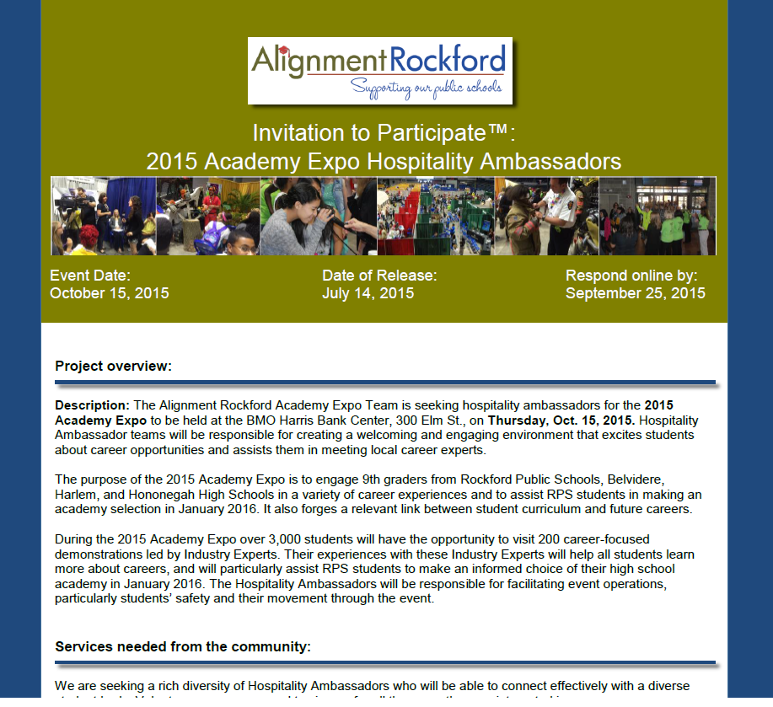
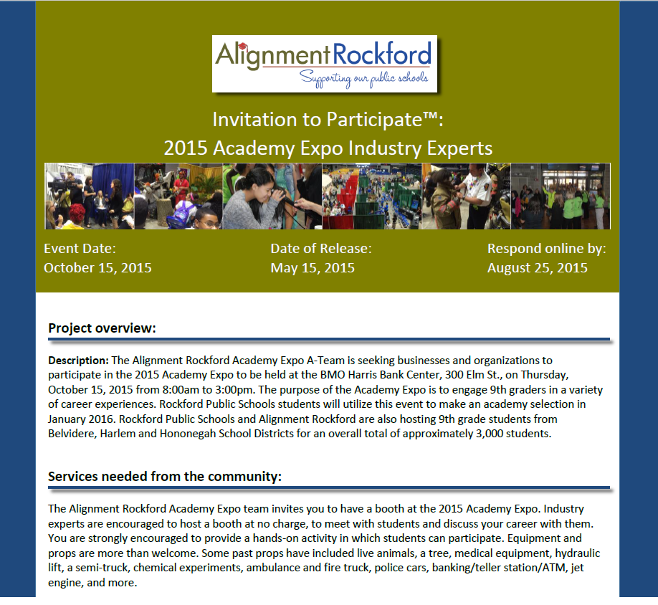
Academy Expo

Slide 26
ACADEMY EXPO TIMELINE
2012
2014
2015
2013
Moved to BMO Harris Bank Center’s first floor (Local civic center)
All 9th graders from all four high schools, alternative high schools, and 10th through 12th graders from Jefferson High School
Jefferson High School’s gym
67 businesses
Jefferson High School freshmen
BMO Harris Bank Center’s first floor
All 9th graders from Rockford Public Schools
350 students from Belvidere School District
135 businesses
700 volunteers
BMO Harris Bank Center’s first and second floors
All 9th graders from Rockford Public Schools
9th graders from Belvidere, Harlem and Hononegah
Total 3,000 students
Total 2,000 students
150 businesses
900 volunteers
120 businesses

Slide 27
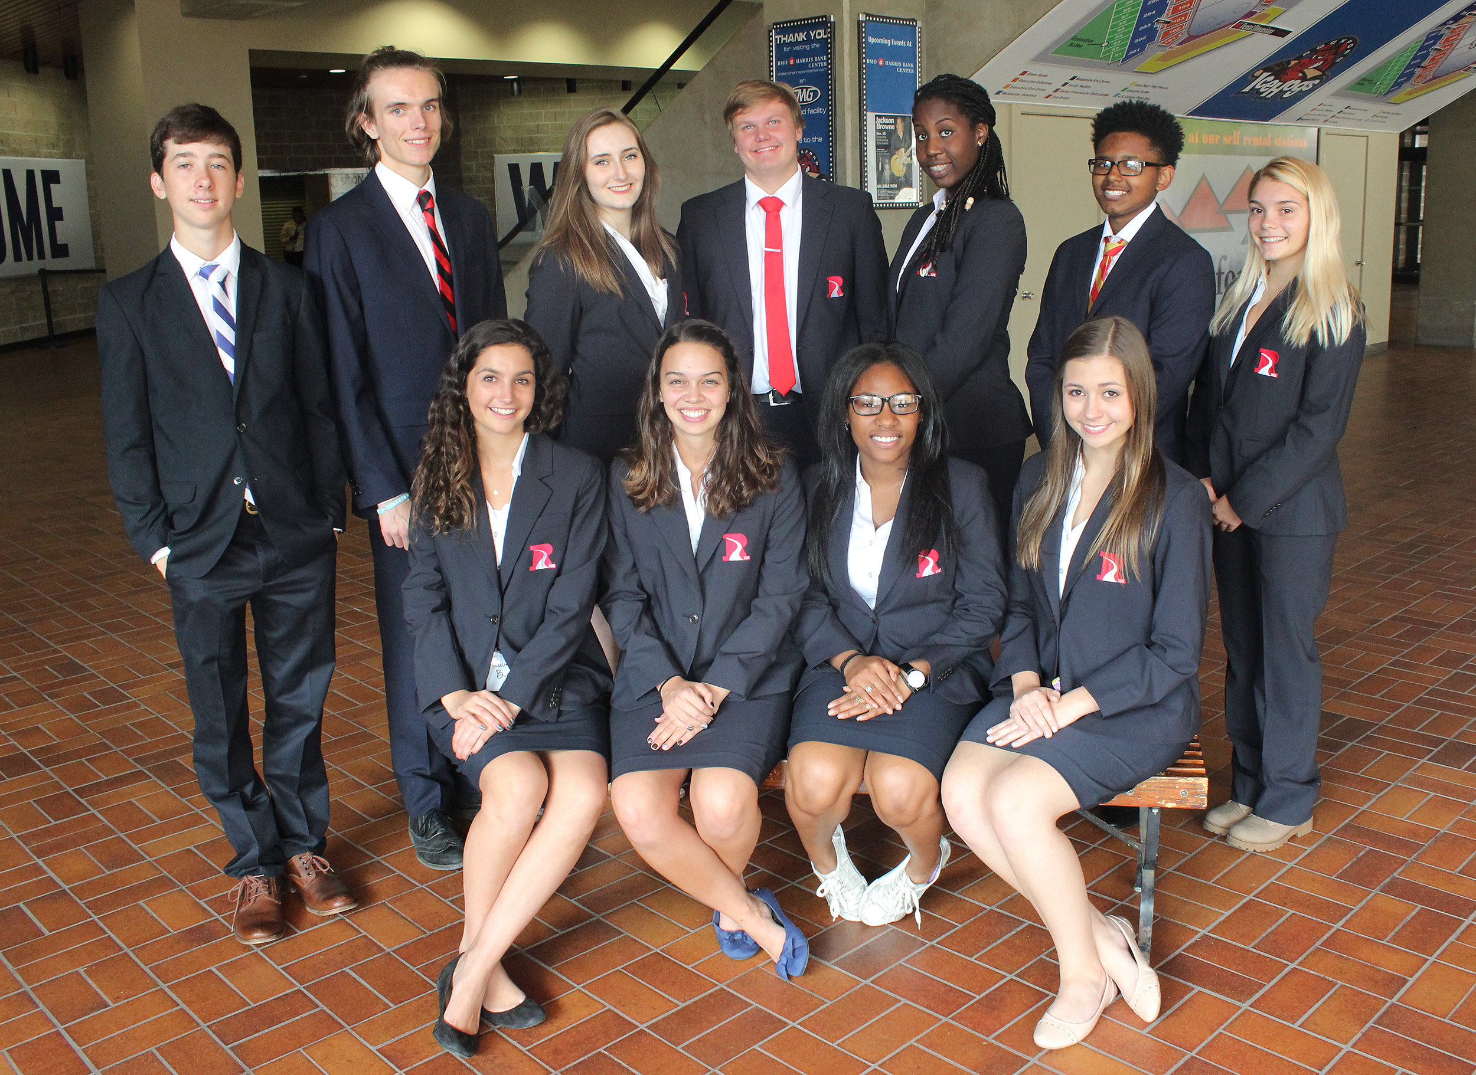
Student Ambassadors
Welcome guests
Give VIP tours
Booth judging
Press conference

Slide 28
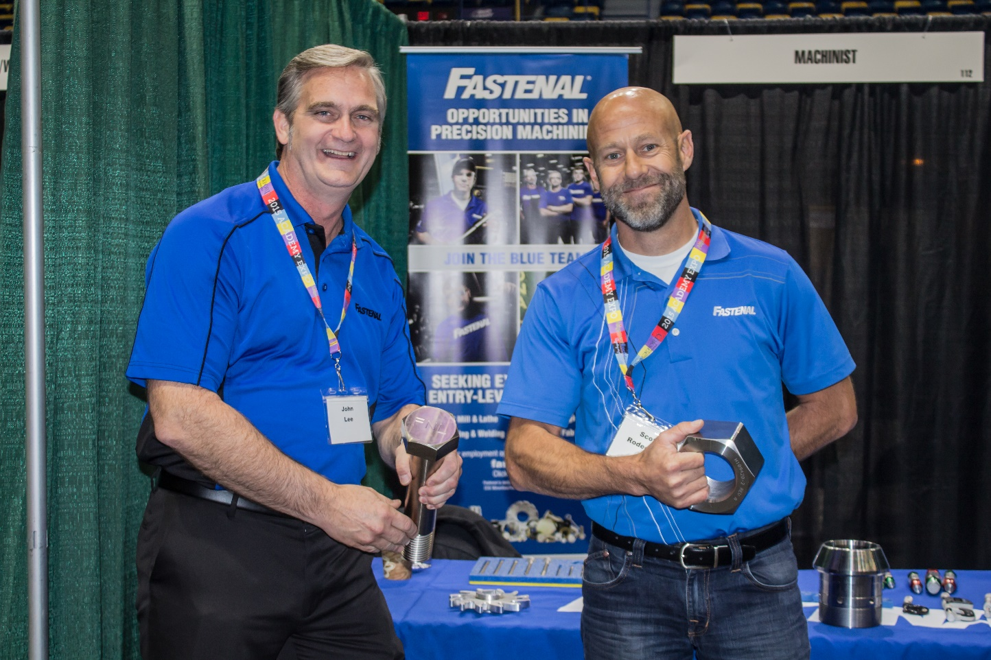
Industry Experts
Develop a hands on career demonstration
Attend a collaboration event
Set up day before event
Volunteer to staff booth day of event

Slide 29
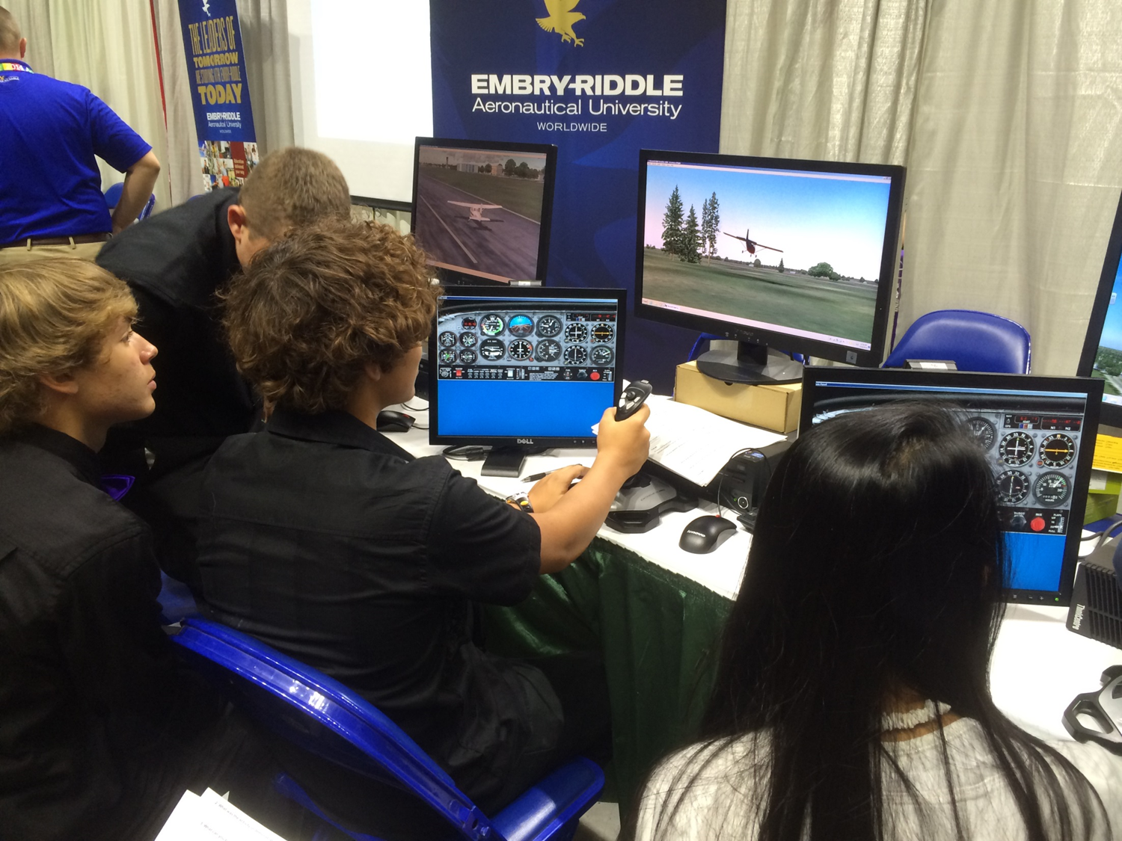
Flight simulators

Slide 30
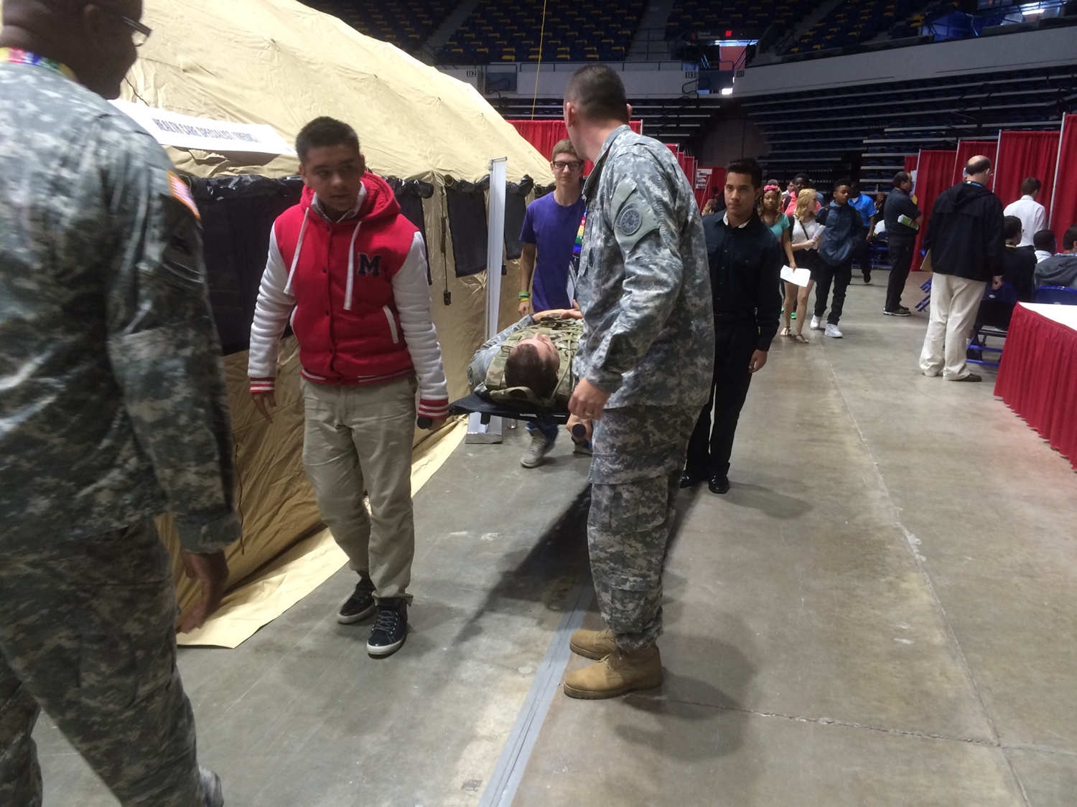
Army medic

Slide 31
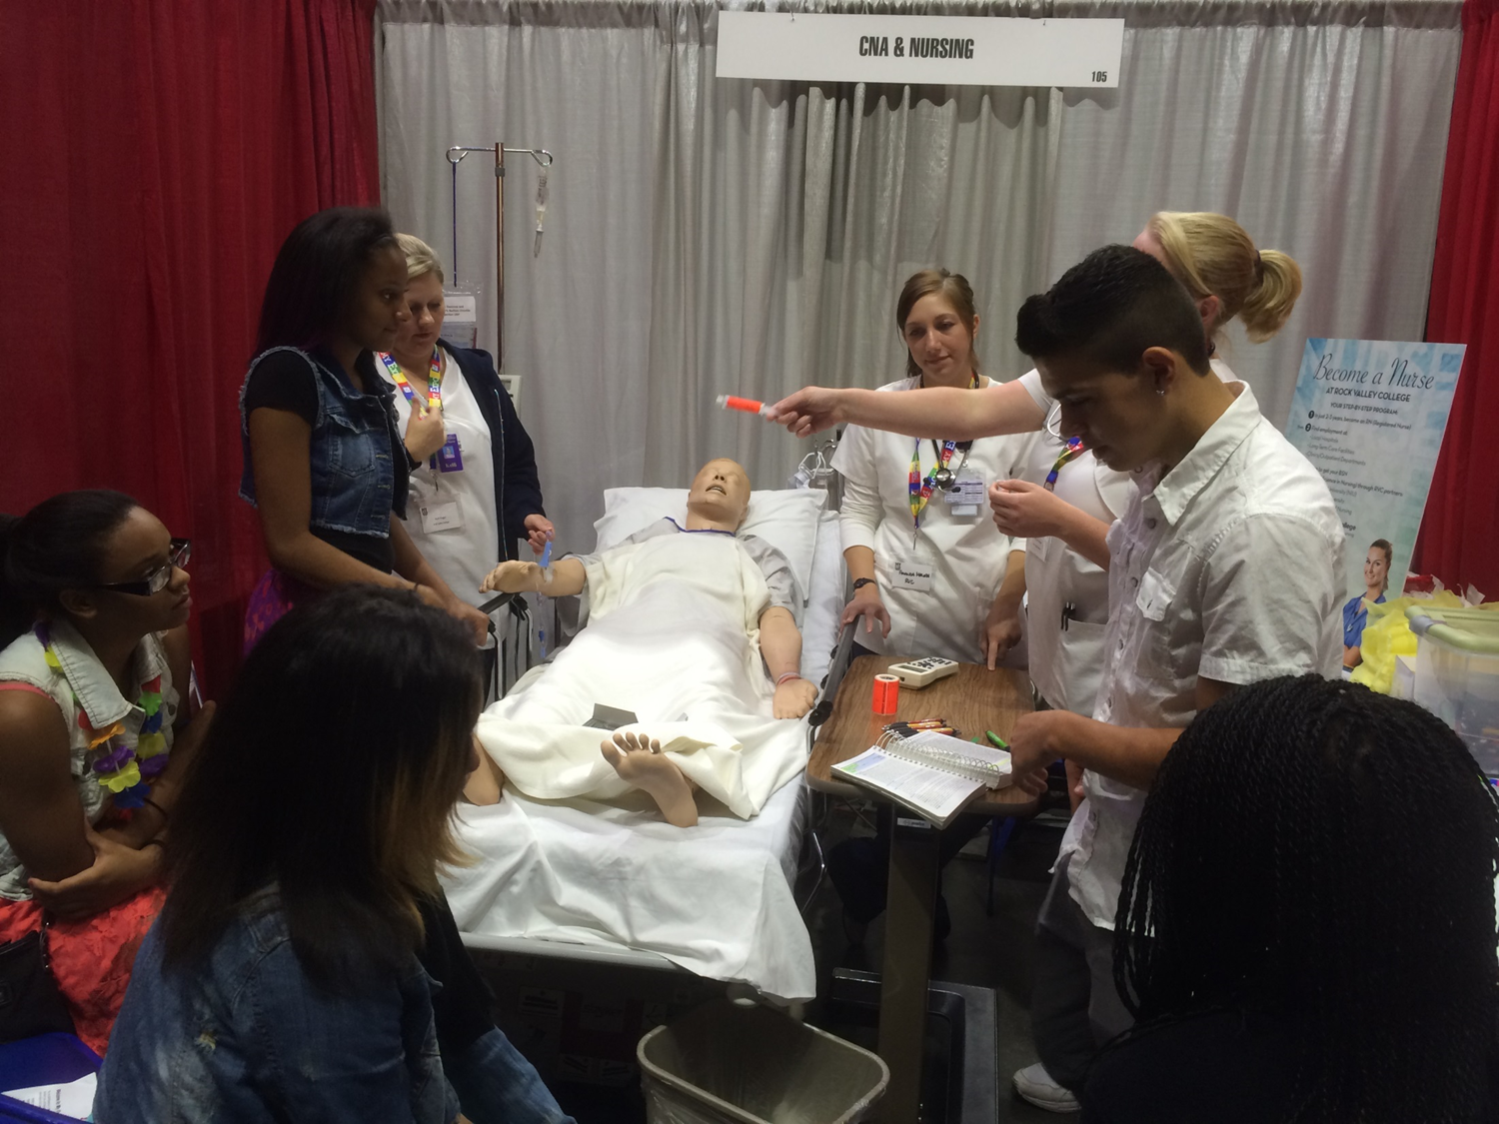
CNA & Nursing

Slide 32
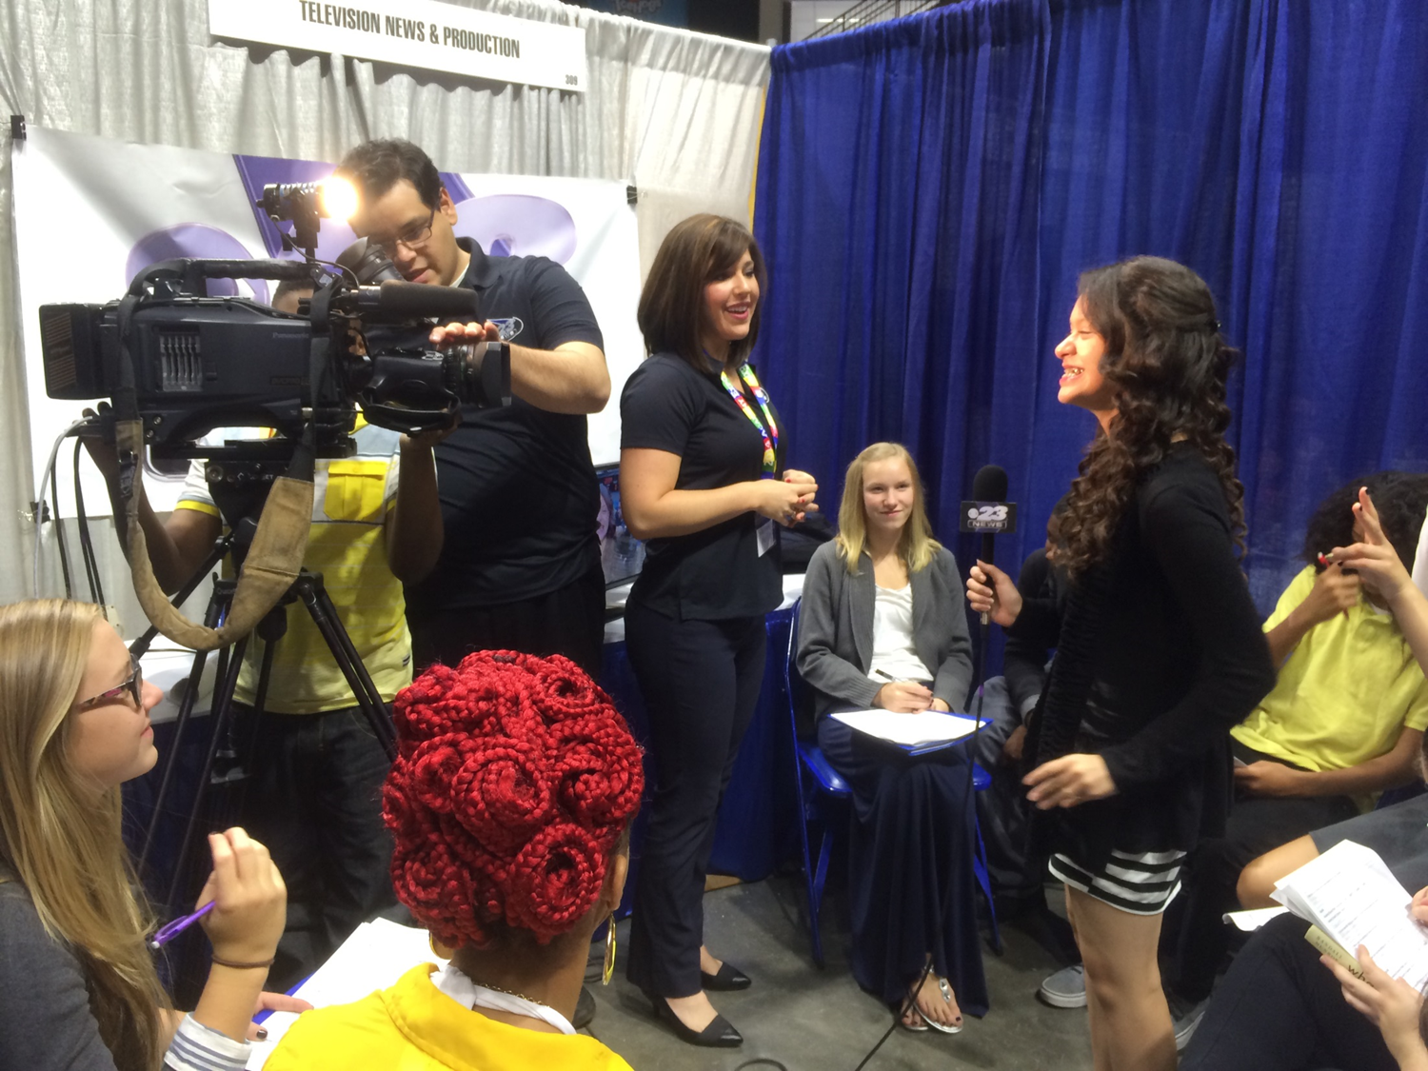
TV broadcasting & production

Slide 33
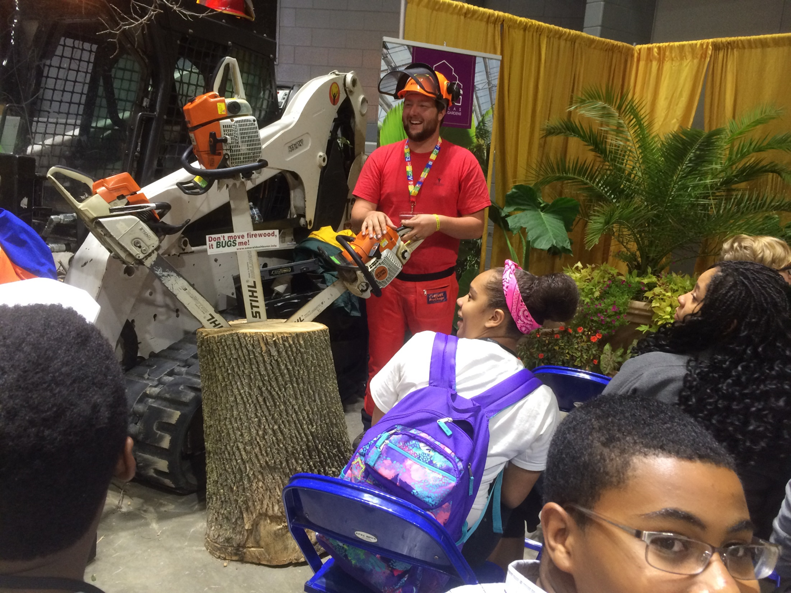
Horticulture

Slide 34
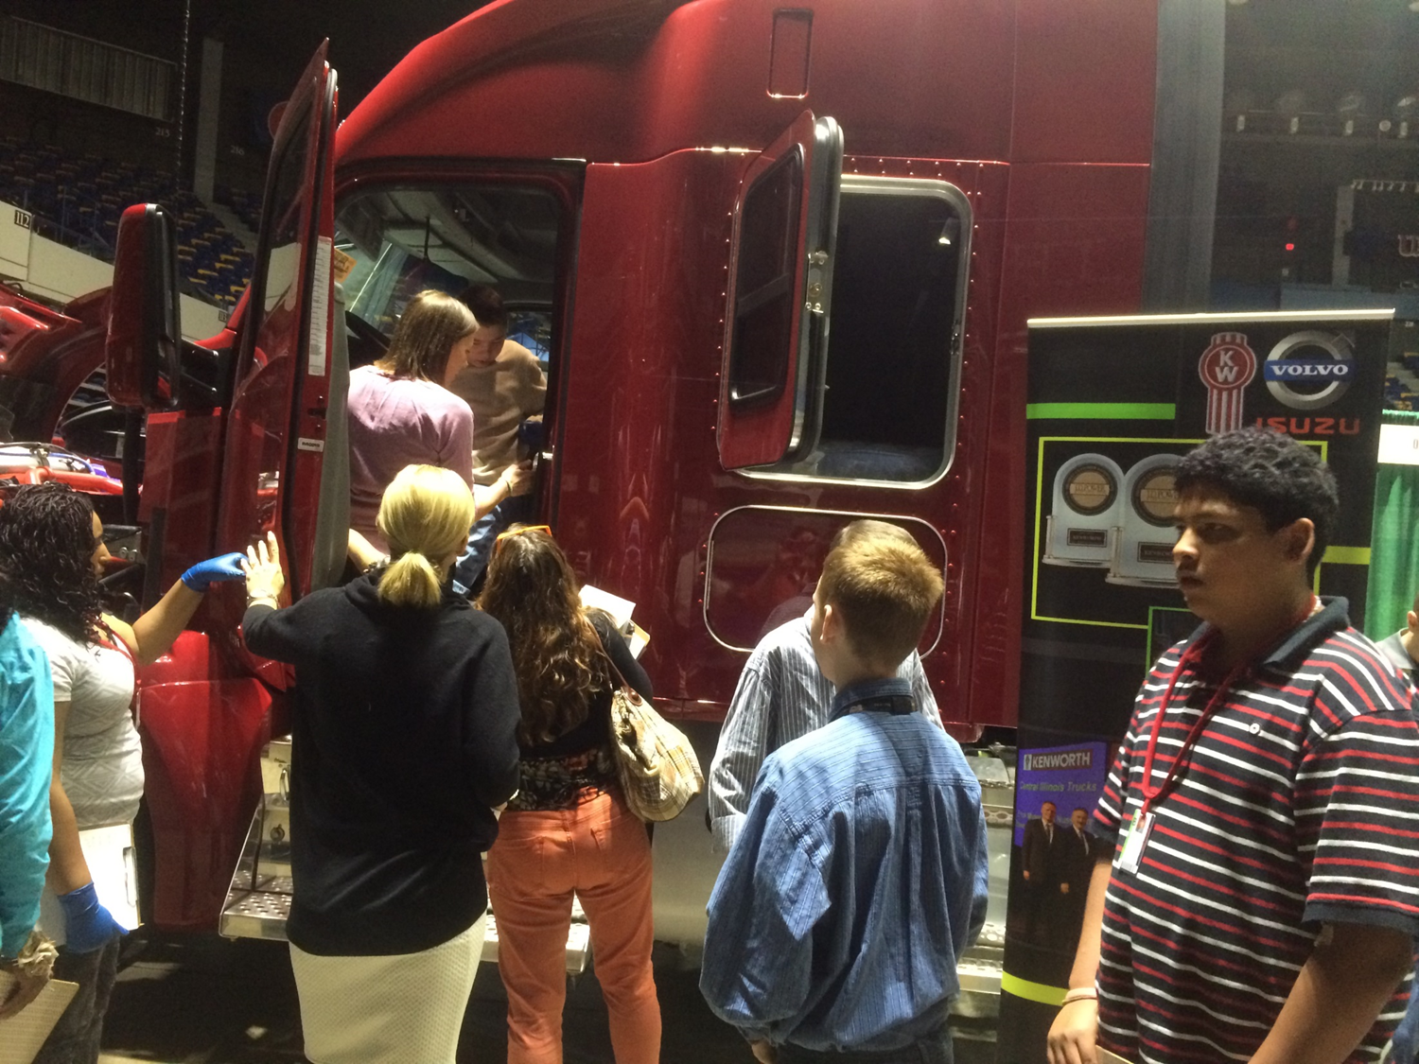
Truck Driving

Slide 35
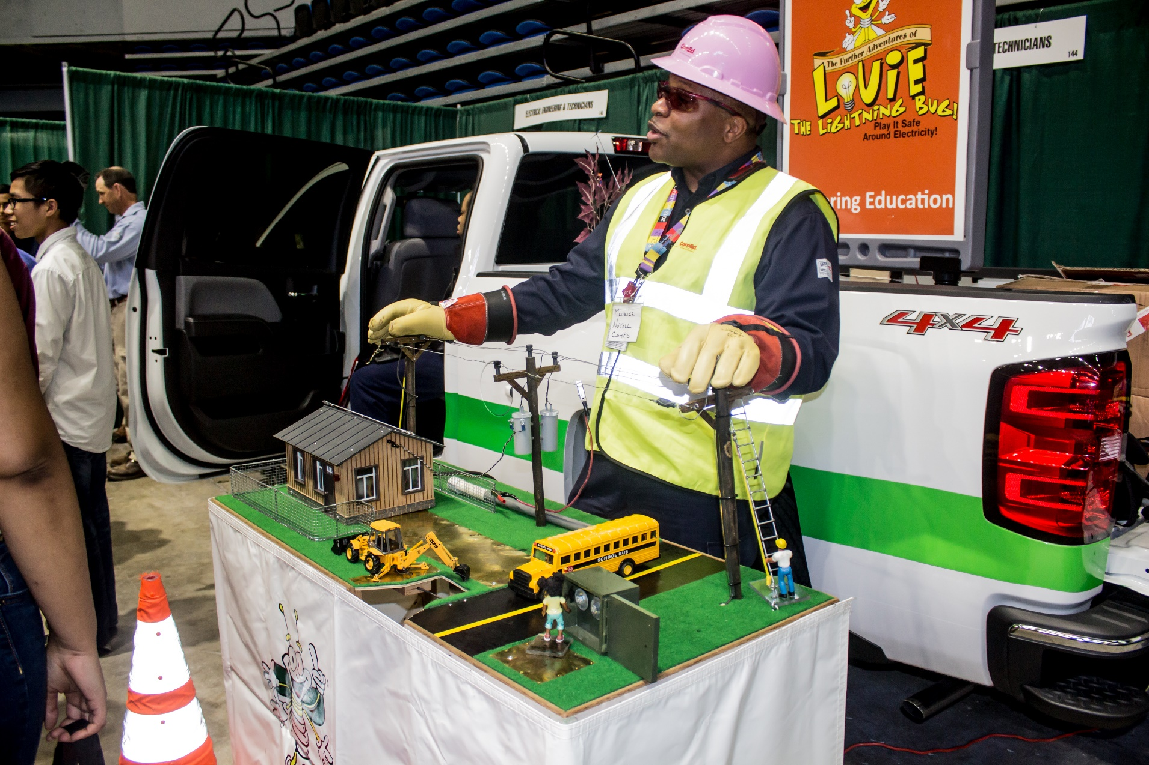
Electrician

Slide 36
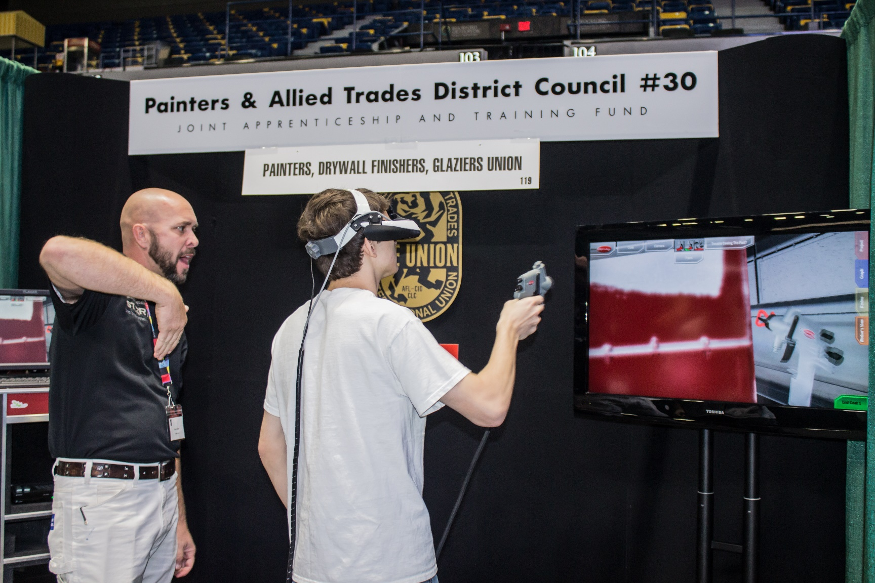
Skilled Trades

Slide 37
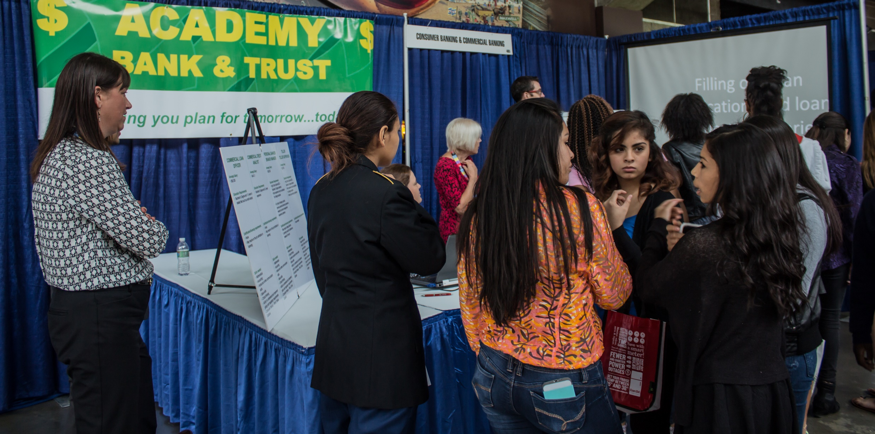
Banking/Lending

Slide 38
Student Prep
Logistics
Shaking Hands
Appropriate Dress
Questioning Practices

Slide 39
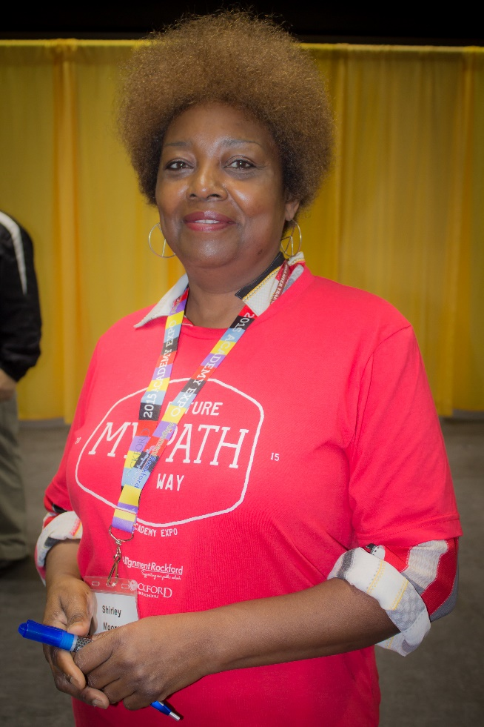
Hospitality Ambassadors
Volunteer Opportunities:
Assist with set up day before event
Registration of volunteers
Food service
Transportation
Booth judges
Emergency response
Photography
Refreshment providers

Slide 40
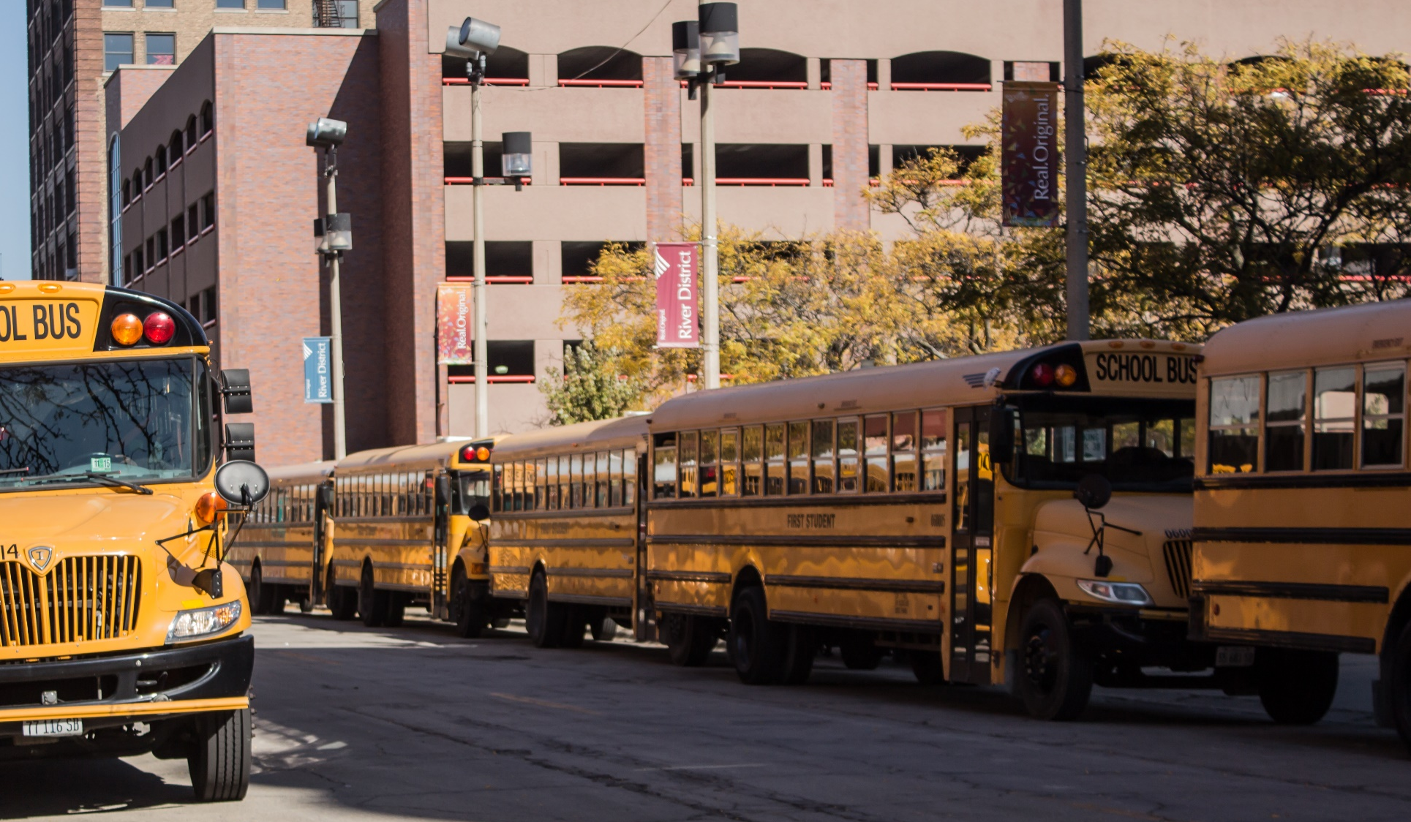

Student Prep

Slide 41
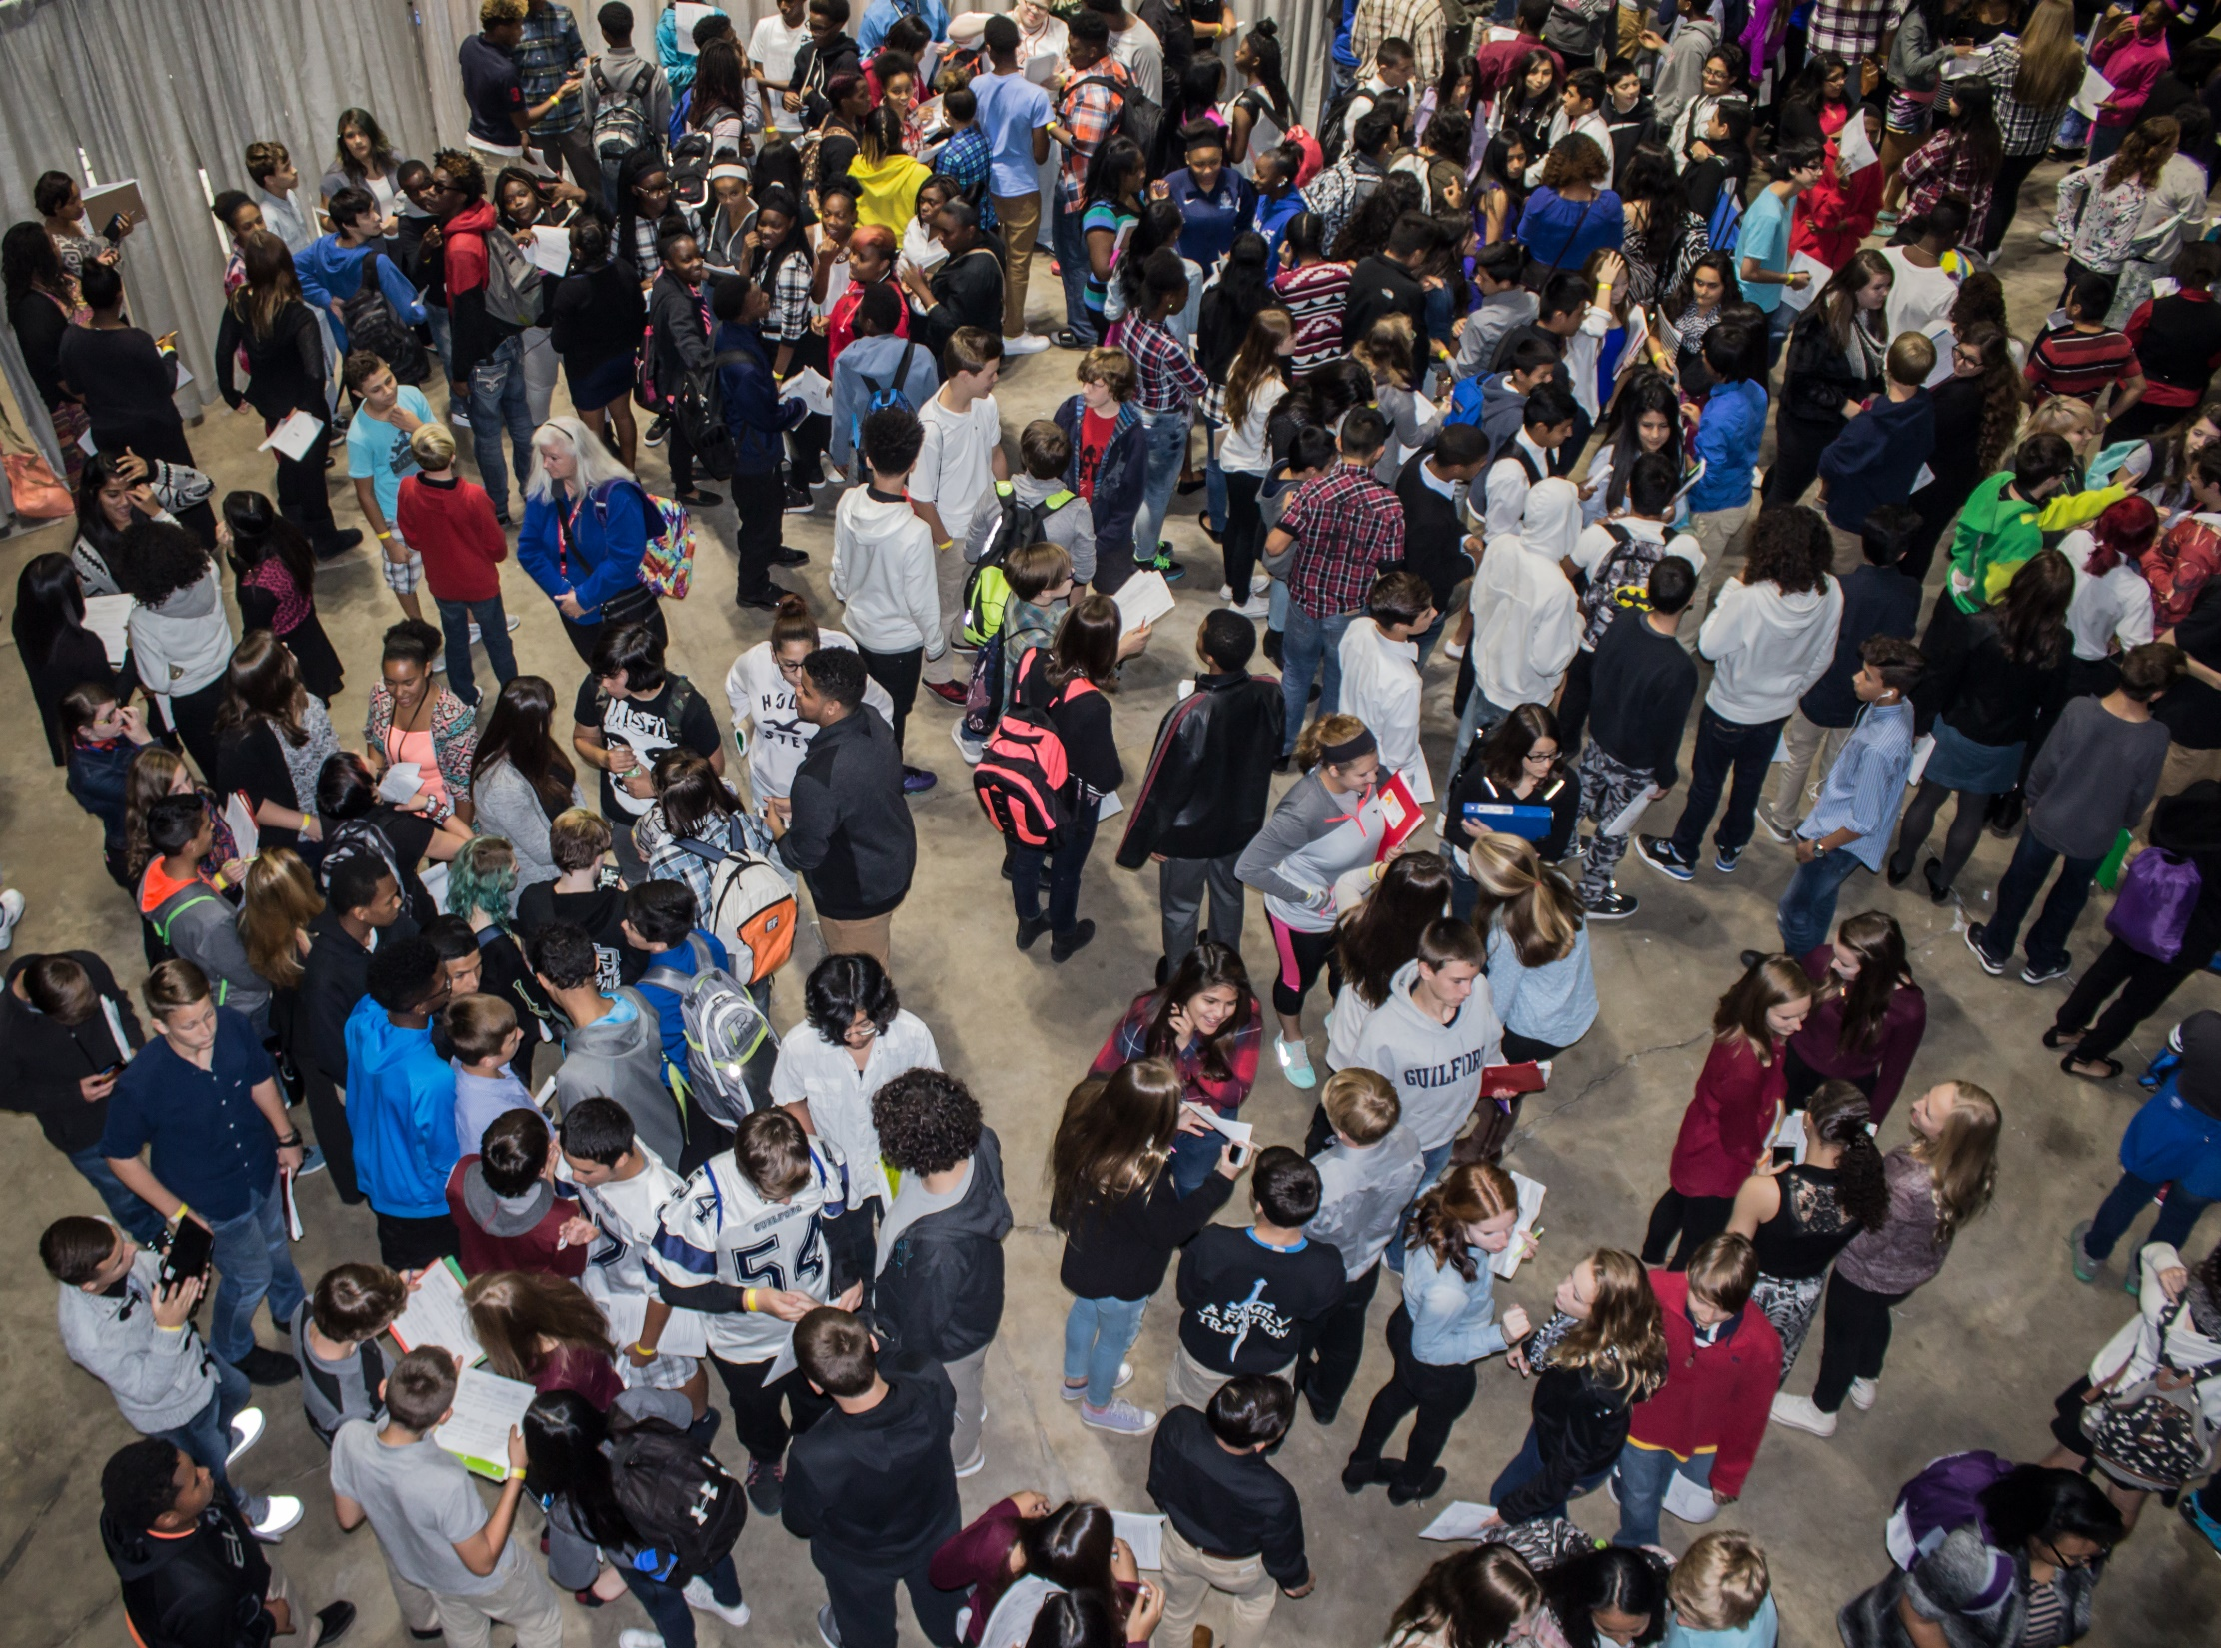
Banking/Lending

Slide 42
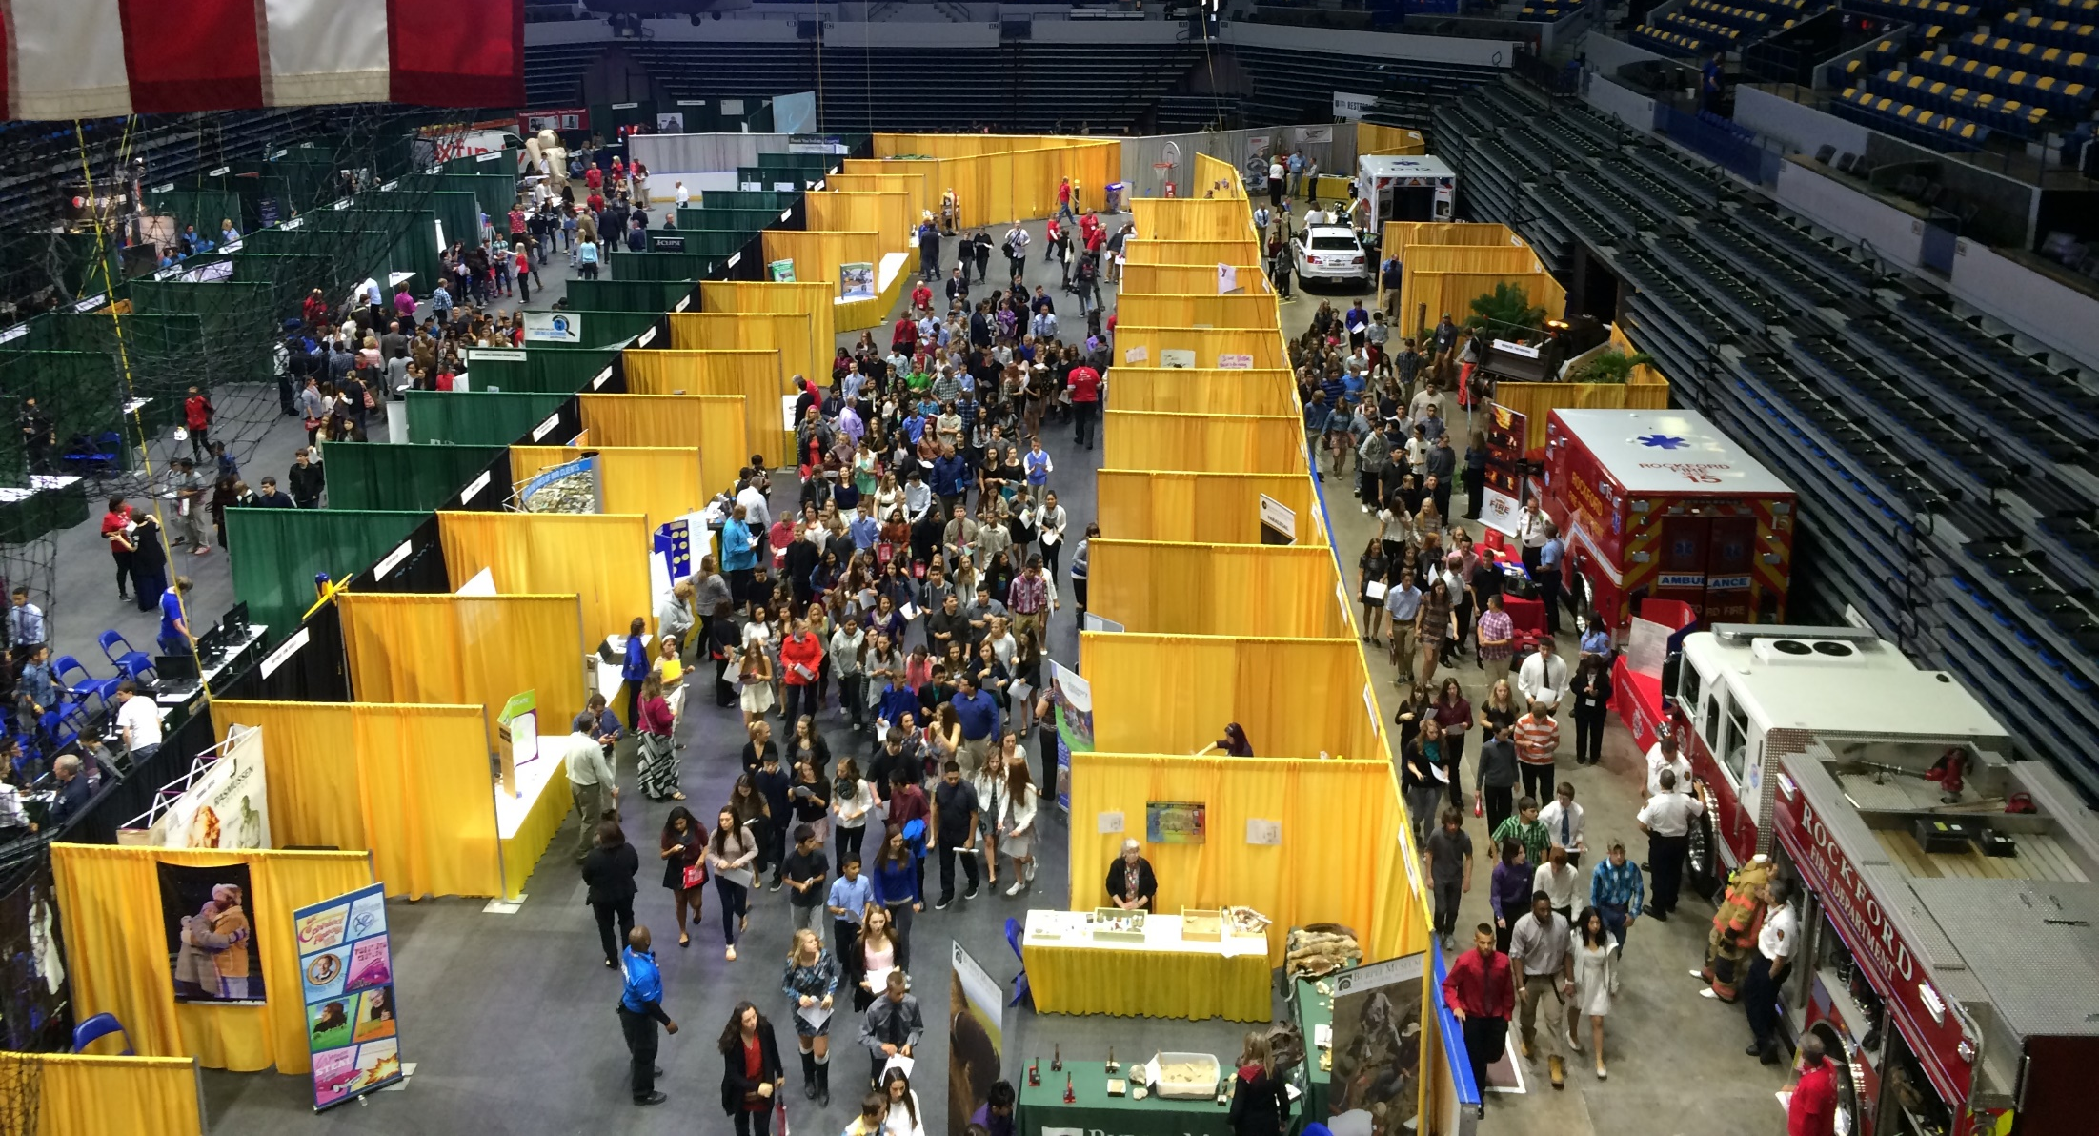
First floor layout

Slide 43
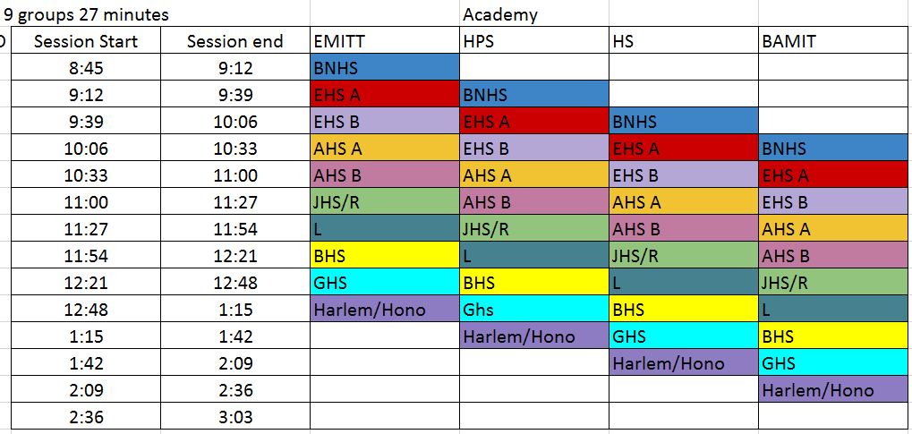

Slide 44
Security
Building Exterior – Rockford Police
Building Interior –
  BMO Harris Police & Security
  RPS 205 Police & Security
  RPS 205 and BSD 100 Staff
  Hospitality Teams – geographic assignments
  Radios on each aisle – look for the shirt
  EMT team on site

Slide 45
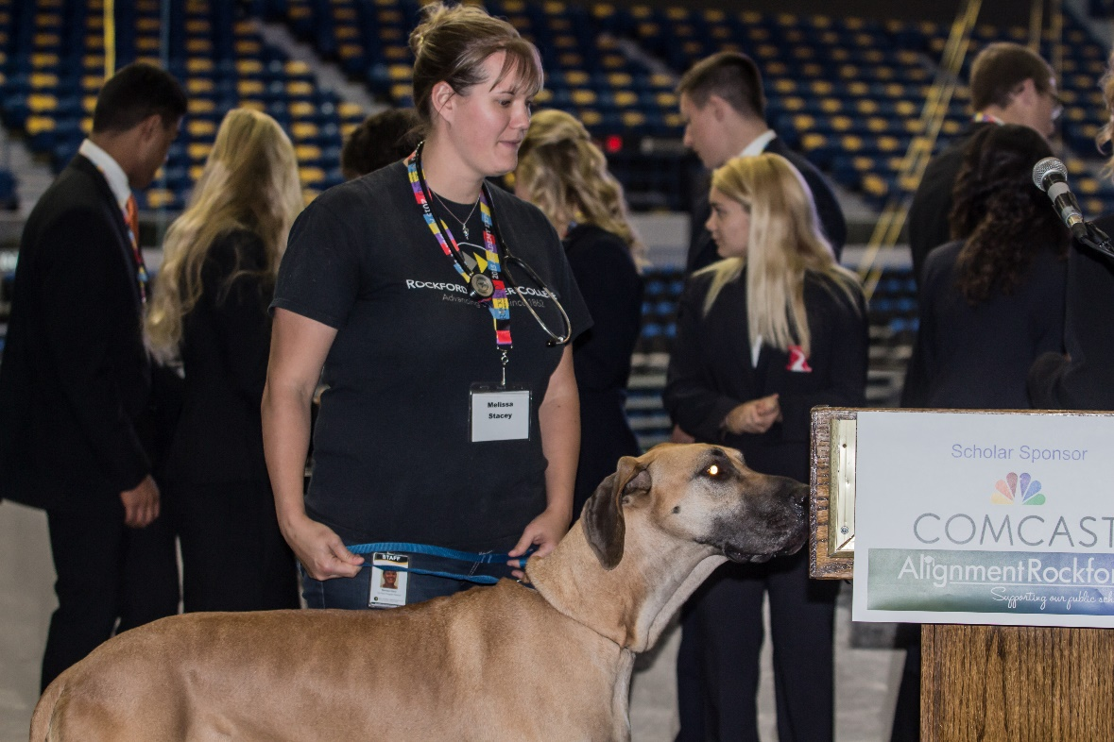
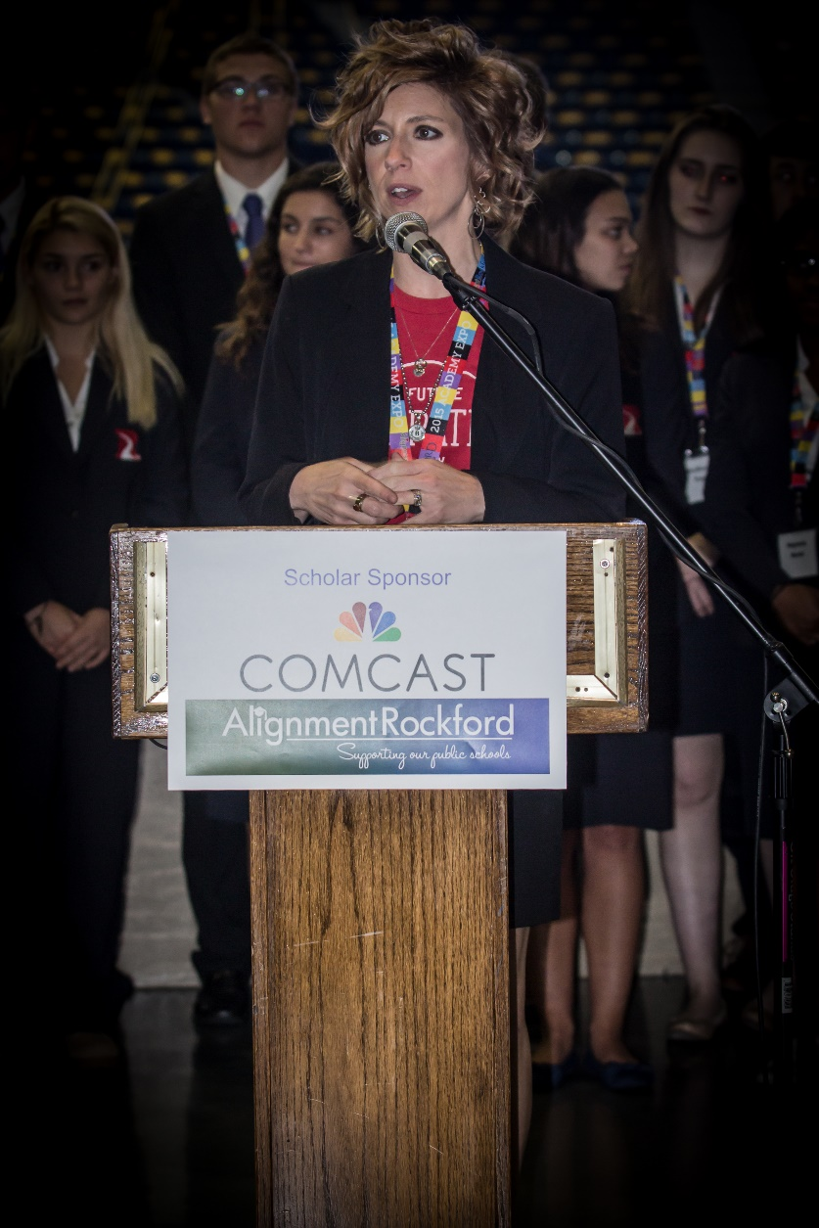
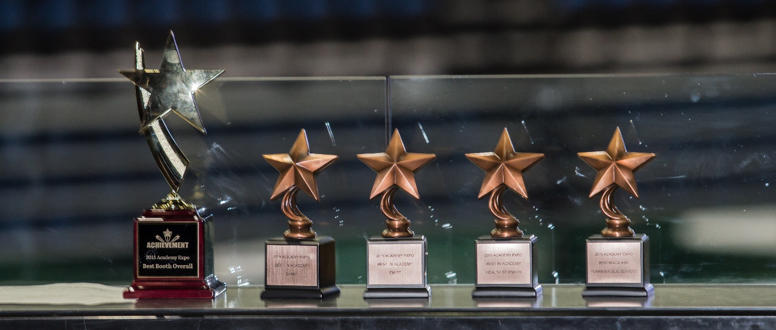
Media/PR

Slide 46
Thank you!
www.alignmentrockford.com

